Slide 1
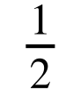
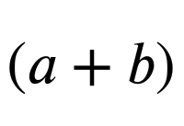
Problem solving with expressions and formulae
Task A: Forming expressions for area
Here are some formula for the area of 2D shapes which may help you with the following task.
a
l
b
h
w
h
b
area = width × length
area = × base × height
area = × × height
Where a and b are the parallel sides.
1) Write a sentence explaining why the area of this shape can be written in each of the following ways:
a) (x − 4)²
b) (x − 4)(x − 4)
c) x² − 8x + 16
x − 4
2) Draw a rectangle with an area of (6 + y)(2 + y) write a different expression for the area of your rectangle.

Slide 2
Problem solving with expressions and formulae
(4x + 5)(6x + 2)
3a) Explain why the area of this shape be written as
b) Write the expression for the area of this shape in two different ways.
6x + 2
4x + 5
c) Draw and label a triangle with area (x + 1)(3x − 2)
4) Match these shapes to the correct expression for their area.
a
b
2x + 2
c
d
x + 2
x + 1
x + 2
x + 1
4x − 4
4x − 4
4x − 4
2x − 2
e
x² − 1
f
2x²+ 2x − 4
g
3x²+ 2x − 1
h
4x²+ 4x − 8

Slide 3
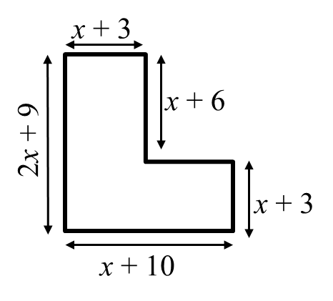
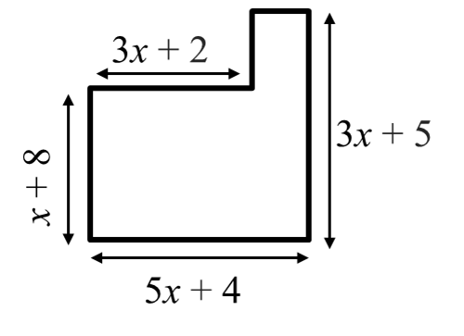
Problem solving with expressions and formulae
Task B: Area of compound shapes
1) Calculate a simplified expression for the area of this shape.
2) Calculate a simplified expression for the area of this shape.
3a) Calculate a simplified expression for the area of the shaded shape.
x + 7
x − 2
x − 2
x + 12
b) The area of the shaded shape is 149 square units. Use this to find the value of x

Slide 4
Problem solving with expressions and formulae
4a) Calculate a simplified expression for the area of the shaded shape.
Not drawn to scale
3x
4x − 1
2x + 7
6x − 9
b) The area of the shaded shape is 99 square units. Use this to find the value of x
5) Four identical rectangles sit round the outside of a shaded square.
a) Find a simplified expression for the area of one rectangle.
b) Find a simplified expression for the area of the whole shape.
c) Find a simplified expression for the area of the shaded square.
2x + 3
x + 2
Mathematics in Education and Industry
v2.3

